Slide 1
Preventing Discrimination & Harassment at UC San Diego
Office for the Prevention of Harassment & Discrimination - OPHD
201 University Center (Corner of Gilman and Myers)
858.534.8298
ophd@ucsd.edu
Reportbias.ucsd.edu
Helen Kaiser
Complaint Resolution Officer
Notes:
Math-- TAs – mostly PhD and MA students
OPHD and what we do
--policies around discrimination, sexual harassment and sexual violence
--your role in responding to these situations

Slide 2

OPHD – What We Do
Serve the entire UC San Diego community
Neutral and impartial factfinders
Oversee non-discrimination policies
Serve as Title IX Office
Provide education & training
Resolve informal complaints
Investigate formal complaints
Respond to Report Bias online complaints
What happens if I file a complaint?
An OPHD investigator will reach out to the Complainant (or Reporting Party)
OPHD will provide options and resources
OPHD helps find solutions and may help with interim relief
Notes:
We don’t decide the discipline –
What is Title IX? - 1972 – part of education amendment
Anti-gender discrimination law in any education program or activity receiving Federal financial assistance.
2011 "Dear Colleague" letter, - take immediate and effective steps to end sexual harassment and sexual violence”
Requires Identification of Responsible Employees
OUR OFFICE ENSURES UCSD IS FOLLOWING SEVERAL LAWS

Slide 3

University of California Nondiscrimination Policies
UC Nondiscrimination Policy
Prohibits harassment and discrimination based on protected categories such as age, ancestry, citizenship, disability, gender, gender identity, medical condition, national origin, pregnancy, race, religion, sex, sexual orientation, and veteran status.
UC Policy on Sexual Violence and Sexual Harassment
Prohibits sexual harassment and sexual assault, domestic violence, dating violence and stalking.

Slide 4

Protected Categories in California
Age
Ancestry
Citizenship
Color
Disability (mental or physical)
Gender
Gender Expression
Gender Identity
Genetic Information
Marital status
Medical condition
Military and veteran status
National origin
Pregnancy
Race
Religion
Sex
Sexual orientation

Slide 5
Sexual Harassment
There are two types of Sexual Harassment that violate the law and UC Policy:
Quid Pro Quo --“this for that” (i.e. sexual favors)
Hostile Environment – (unwelcome conduct of a sexual nature that is so severe or pervasive that it interferes with the educational or work environment of a reasonable person in the complainant’s position)
Notes:
Most frequent type of case OPHD receives

Slide 6
Questionable Conduct
What kinds of behavior might constitute sexual harassment?
Sexual jokes, banter, comments, advances, personal stories
Sexually explicit or suggestive notes, emails, or other communication
Physical behavior such as touching, kissing, blocking someone’s way, gestures
Photos of sexual/graphic nature
Note:
-- Does not require intent to harass
-- Does not require sexual desire
-- Certain types of harassment could be considered stalking under University policy
-- “Severe and pervasive” sets up a sliding scale for conduct
Notes:
Does not require intent
Generally, verbal communication is less severe, physical contact is considered more severe. BUT depends on the facts in the case, very case specific analysis.
Other considerations –
How it effects the other person, the impact?
When would a reasonable person say that it is impacting work environment?

Slide 7
Sexual Violence
CONSENT
Consent is informed. Affirmative, unambiguous, and conscious decision
Consent is voluntary. Given without coercion, force, threats, or intimidation.
Consent is revocable. Must be ongoing through sexual activity and for each encounter
Silence does not equal consent
Consent cannot be given when a person is incapacitated (asleep, unconscious, or otherwise not able to understand what is happening, for example due to drugs or alcohol).
Types of Prohibited Conduct:
Sexual Assault
Dating/Domestic violence
Stalking
Invasion of Privacy

Slide 8

What is a “Responsible Employee”?
Any University employee who is not a “confidential resource” and who receives, in the course of employment, information that a student (undergraduate, graduate, professional student) has suffered sexual violence, sexual harassment or other prohibited behavior shall promptly notify the Title IX Officer or designee.
Notes:
“in the course of employment” -- be mindful of the hat you are wearing if/when you receive information, consult with supervisor if unsure whether to report
What to say – need to make a report to OPHD, someone will be contacting you from that office, how would you like to be contacted? Up to you whether you want to respond, etc.
How to say – with care, compassion
Resources to provide – confidential and non-confidential

Slide 9
Confidential Resources
Faculty Staff Assistance Program
Office of the Ombuds
CARE at SARC
Student Legal Services
Counseling & Psychological Services

Slide 10
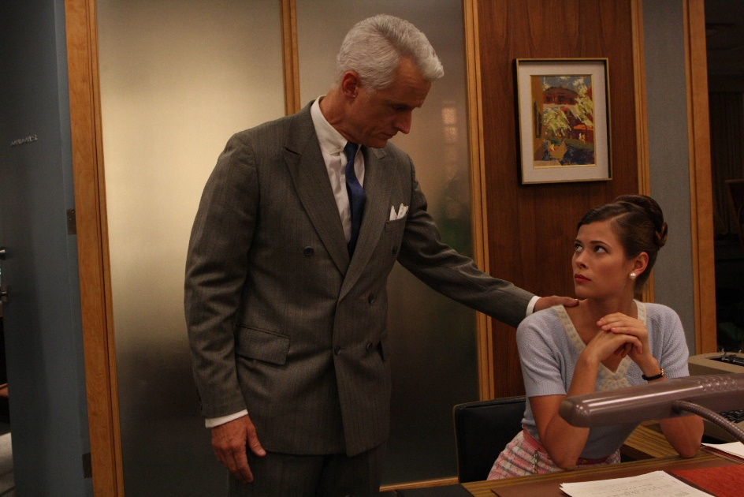
Romance in the Workplace
Consensual relationships where there is a power differential between the parties pose potential and real conflicts of interest.
If you have the ability to grade, evaluate, advance, promote, recommend, advise, or otherwise influence the employment or academic status of the other individual then you cannot be in a relationship.

Slide 11
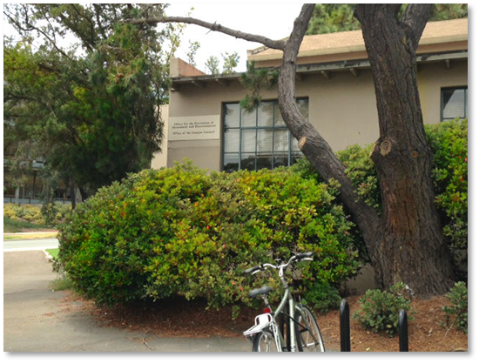
Contact OPHD
Office for the Prevention of Harassment & Discrimination
201 University Center
(Corner of Gilman and Myers)
858.534.8298
ophd@ucsd.edu
ophd.ucsd.edu
Reportbias.ucsd.edu

Slide 12
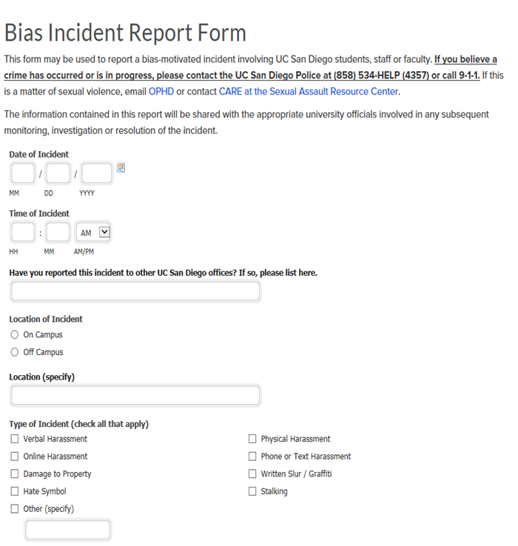
Report Bias Online
Reports can be made online at Reportbias.ucsd.edu.
Make reports anonymously or identify parties; make us aware of what’s going on (Note: Responsible Employees cannot report anonymously).
Confidentiality will be respected to the fullest extent possible. Note: certain reports may require revealing facts or identity, such as cases of violence or where safety of the community could be at risk.

Slide 13

Questions?

